Slide 1
Object-Oriented Programming (OOP)
Week – 08
Mar 23-27, 2020
Instructor: Basit Ali
Email: basit.jasani@nu.edu.pk
Object-Oriented Programming (OOP)

Slide 2
Friend Function
A friend function of a class is defined outside that class' scope but it has the right to access all private and protected members of the class.
Even though the prototypes for friend functions appear in the class definition, friends are not member functions.

Slide 3
Friend Function
To declare a function as a friend of a class, precede the function prototype in the class definition with keyword friend as follows

Slide 4
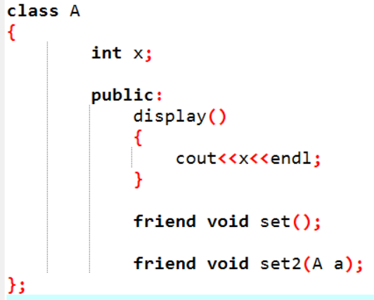
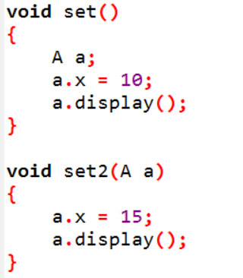
Implementation

Slide 5
Operator Overloading
In C++, we can make operators to work for user defined classes.
This means C++ has the ability to provide the operators with a special meaning for a data type, this ability is known as operator overloading.

Slide 6
Operator Overloading (Continue..)
For example, we can overload an operator ‘+’ in a class like String so that we can concatenate two strings by just using +
Other example classes where arithmetic operators may be overloaded are Complex Number, Fractional Number, Big Integer, etc.

Slide 7
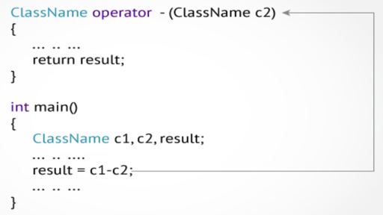
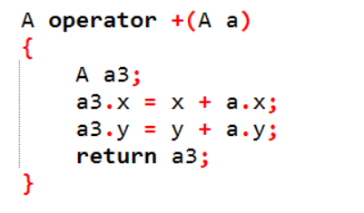
Operator Overloading (Continue..)
Overloaded operators are functions with special names: the keyword "operator" followed by the symbol for the operator being defined

Slide 8
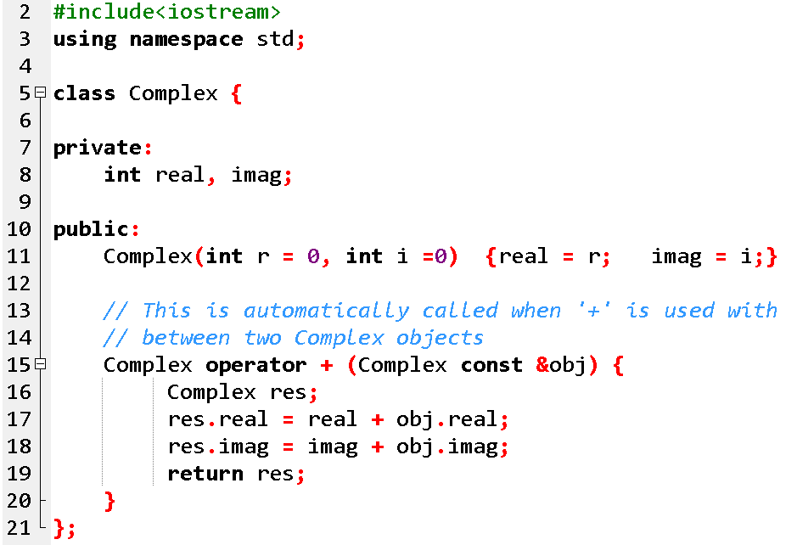
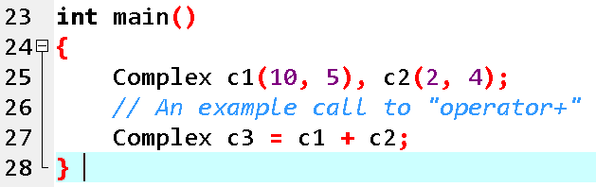
Operator Overloading (Continue..)

Slide 9
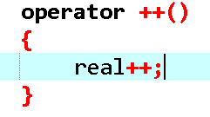
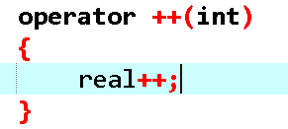
Operator Overloading (Continue..)
++object;
object++;

Slide 10
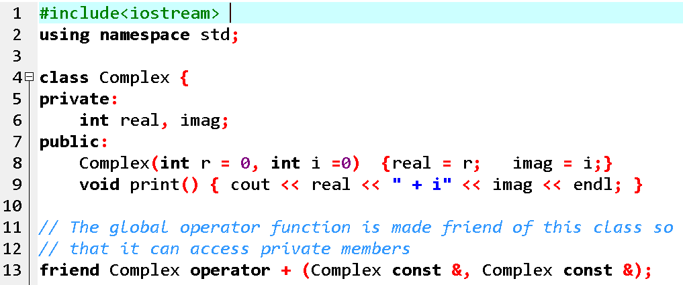
Global Operator Function

Slide 11
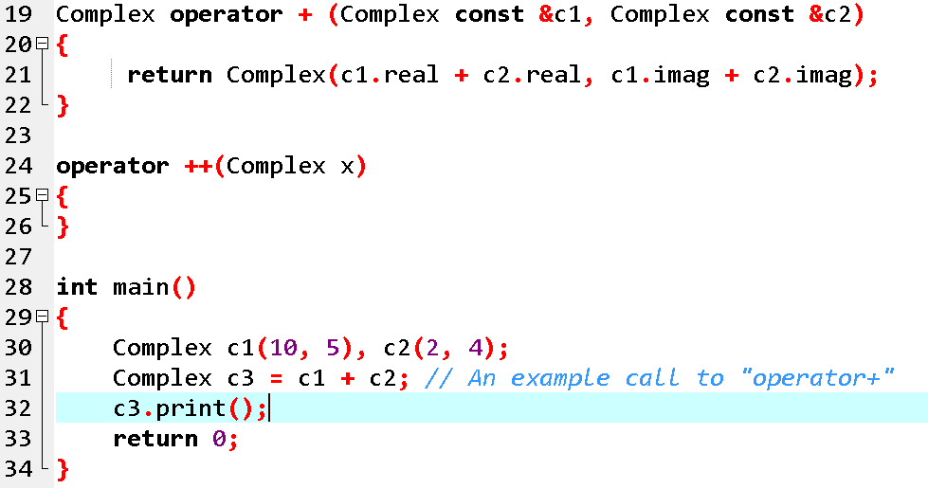
Global Operator Function

Slide 12
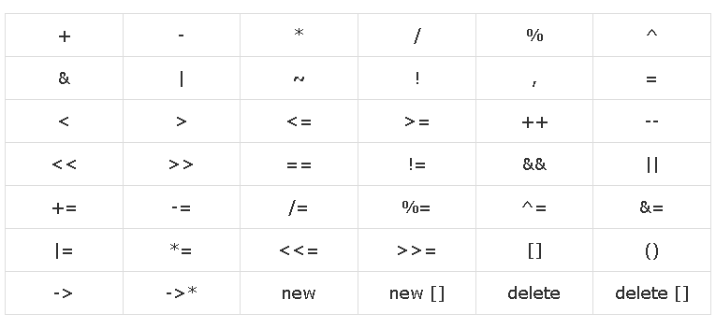
Overload-able Operators

Slide 13
Non-overload-able Operators

